Slide 1
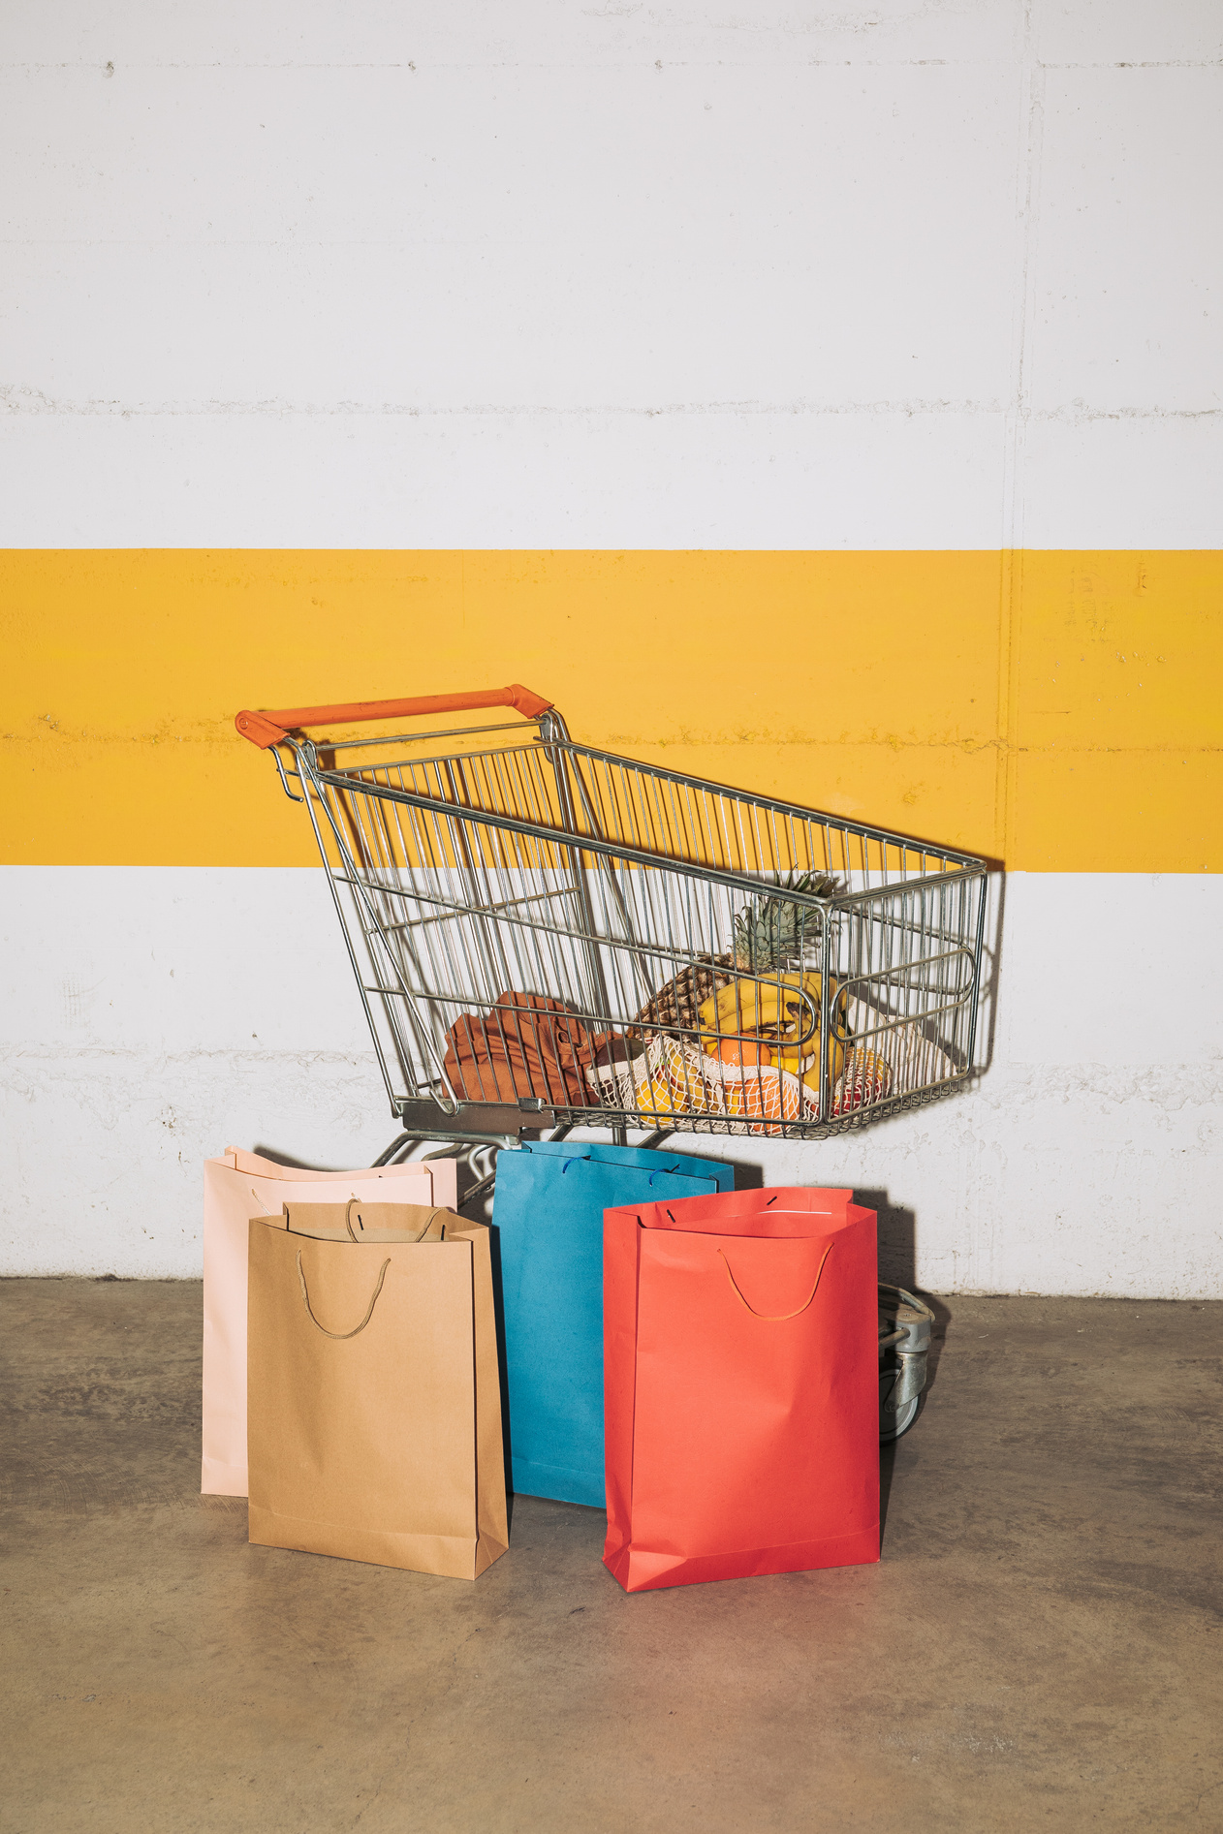

TRENDMART Retail Profitability & Margin Optimisation Analytics
Presented by Tobiloba Adeniyi

Slide 2

Executive Summary
Trendmart
RETAIL MARKET SEGMENTS OVERVIEW
Product Mix Analysis
TrendMart specialises in offering affordable, trend-driven clothing and lifestyle products to middle-income households, students, and budget-conscious families
Store Performance
Market Efficiency
Insights
Recommendations

Slide 3
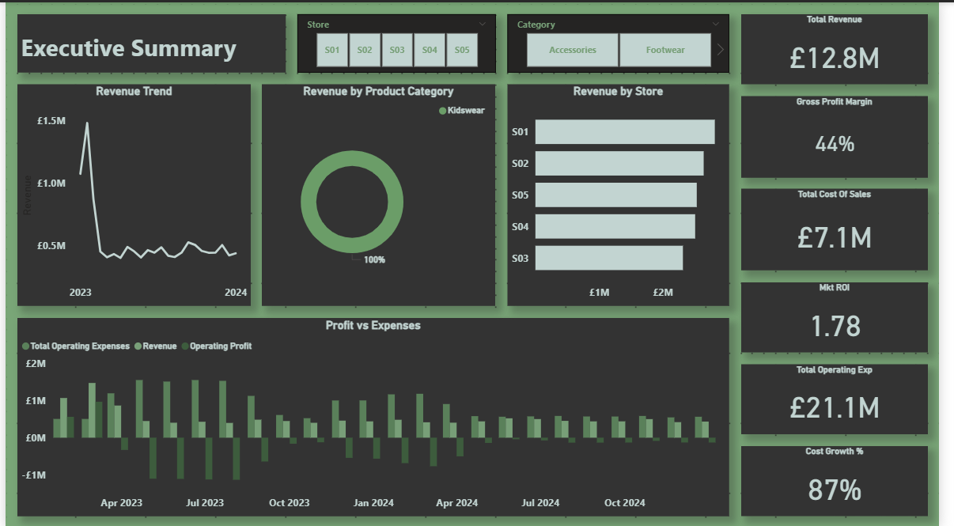

Executive Summary
📊 Insights
💷 Revenue £12.8M but 📉 costs rising fast (Cost Growth 87%).
🏬 Store S01 leads revenue; others underperform.
🧒 Kidswear = 100% revenue in current filter → category dependency risk.
📈 GP Margin 44% shows strong product profitability.
💸 Operating expenses (£21.1M) far exceed revenue → pressure on profit.
📉 Revenue trend declining from the early 2023 peak.
01
🧭 Recommendations
🔍 Investigate cost drivers — reduce operating expenses immediately
.
🎯 Diversify categories beyond Kidswear to reduce revenue concentration.
🚀 Boost high‑performing stores (S01) with targeted marketing
.
Trendmart

Slide 4
Executive Summary
📊 Insights
💷 Revenue £12.8M but 📉 costs rising fast (Cost Growth 87%).
🏬 Store S01 leads revenue; others underperform.
🧒 Kidswear = 100% revenue in current filter → category dependency risk.
📈 GP Margin 44% shows strong product profitability.
💸 Operating expenses (£21.1M) far exceed revenue → pressure on profit.
📉 Revenue trend declining from the early 2023 peak.
01
🧭 Recommendations
🔍 Investigate cost drivers — reduce operating expenses immediately
.
🎯 Diversify categories beyond Kidswear to reduce revenue concentration.
🚀 Boost high‑performing stores (S01) with targeted marketing
.
Trendmart

Slide 5
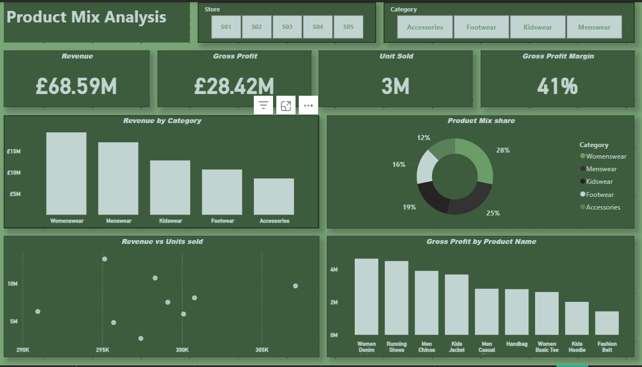
Product Mix Analysis Summary
Overall Performance
Revenue: £68.59M
Gross Profit: £28.42M
Units Sold: 3M
Gross Profit Margin: 41%
Category Performance
👗 Women’s wear (£15M), while Men’s wear (£14M), is the core revenue engine, jointly contributing over half of total sales.
🧒 Kidswear (£10M) provides stable mid‑tier volume.
👟 Footwear (£8M) and
🎒 Accessories (£6M) add incremental revenue and margin diversity.
Trendmart

Slide 6
Product Mix Analysis
📊 Insights
💷 Revenue £68.59M with 41% margin — strong profitability.
🏷️ Women’s wear + Men’s wear = 53% of total revenue.
📦 Units stable (290K–305K) but revenue varies → pricing power.
💡 Top GP items: Denim, Running Shoes, Men’s Chinos.
🥧 Balanced mix reduces risk.
Recommendations
🚀 Prioritize hero products (Denim, Running Shoes).
🎯 Upsell high‑margin categories (Women’s Wear, Men’s Wear).
📈 Strengthen premium pricing where revenue per unit is high.
🔍 Trim low‑margin accessories.
Trendmart

Slide 7
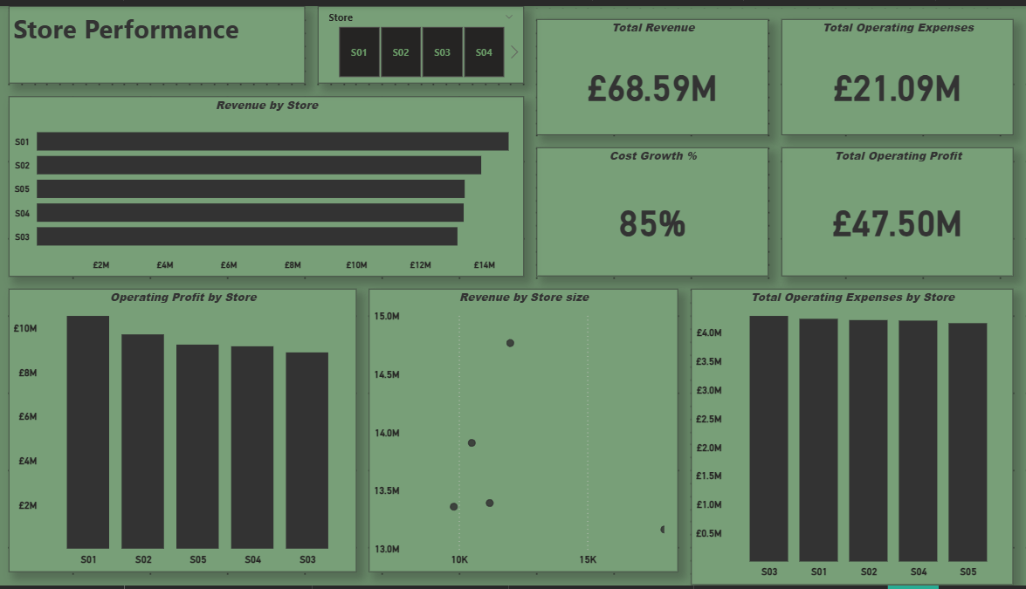
Store Performance Summary
💷 Total Revenue: £68.59M
💰 Total Operating Profit: £47.50M
🧾 Total Operating Expenses: £21.09M
📈 Cost Growth: 85%
🏬 Top Revenue Stores:
S01 (~£14M)
S02 (~£13M)
S05 (~£12M)
💹 Top Profit Stores:
S01 (~£10M)
S02 (~£9.5M)
S05 (~£9M)
Trendmart

Slide 8
Insights
S01 is the best overall performer (highest revenue + profit)
S03 delivers lowest revenue but similar expenses → efficiency gap
Cost growth at 85% signals rising operational pressure
Recommendations
🟢 Optimise operations in S03 to improve efficiency
🟢 Replicate S01’s performance model across other stores
🔴 Monitor rising costs to protect profit margins
Trendmart

Slide 9
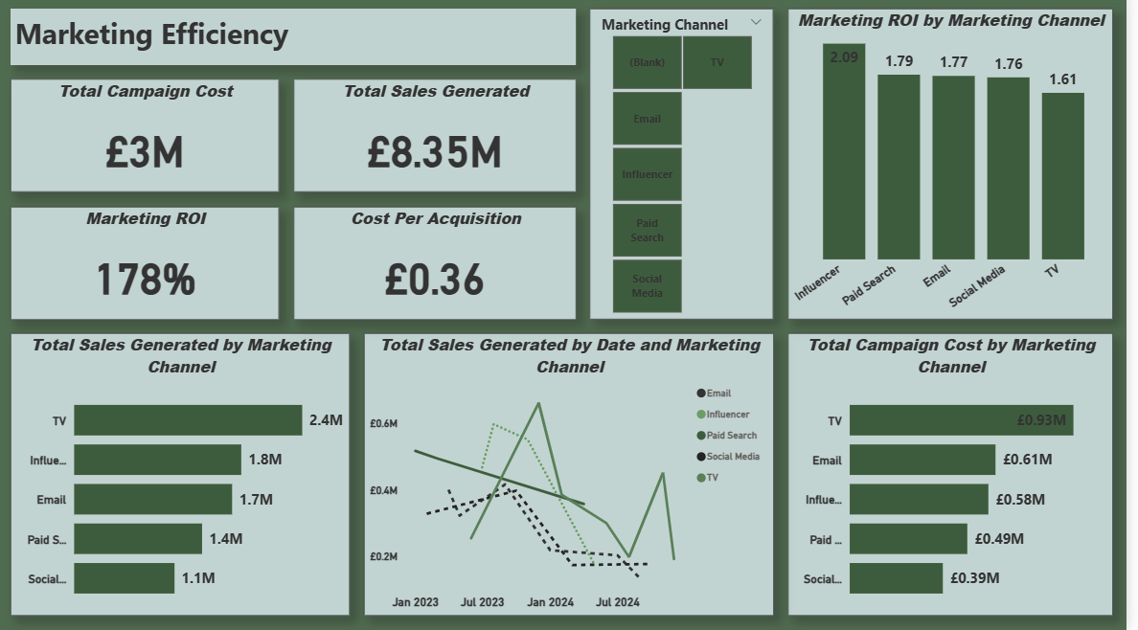

Marketing Efficiency Summary
💷Campaign Cost: £3M
📈 Sales Generated: £8.35M
🔁 ROI: 178%
🎯 Cost per Acquisition: £0.36
🚀 Top ROI Channels:
Influencer (2.09)
Paid Search (1.79)
Email (1.77)
💰 Highest Sales:
TV (£2.4M)
Influencer (£1.8M)
Email (£1.7M)
Trendmart

Slide 10
Insights & Recommendations
📉 TV: Highest spend + lowest ROI
📊 Social Media: Lowest spend + moderate ROI
📈 Trends: Email & Influencer show steady growth
🔍 Overall: Strong ROI and very low CPA
Recommendations
🟢 Increase spend on Influencer, Paid Search, Email
🔴 Reduce reliance on TV
🎯 Maintain low CPA by optimising spend
Trendmart

Slide 11
Trendmart
OVERALL BUSINESS PERFORMANCE — EXECUTIVE INSIGHTS & RECOMMENDATIONS
📊 1. Financial Health Overview
💷 Total Revenue: £68.59M
💰 Gross Profit: £28.42M
📉 Cost Growth: 85–87% (significant pressure on margins)
🧾 Operating Expenses: £21.1M
📈 Gross Profit Margin: 41–44% (strong product profitability)
⚠️ Operating Profit Volatility driven by rising costs and uneven revenue trend.
🛍️ 2. Product Mix Insights
👗 Women’s wear (28%) & Men’s wear (25%) dominate revenue and mix share.
🧒 Kidswear contributes strongly but is over‑represented in some views (100% in filtered dashboard).
👟 Footwear & Accessories underperform relative to other categories.
⭐ Top GP Products: Women’s Denim, Running Shoes, Men Chinos
Customer Metrics
Operational KPIs
Customer KPIs measure acquisition cost retention rate and lifetime value to guide marketing decisions.
Operational KPIs measure inventory turnover fulfillment times and return rates to improve efficiency today.

Slide 12
Trendmart
OVERALL BUSINESS PERFORMANCE — EXECUTIVE INSIGHTS & RECOMMENDATIONS
3. Store Performance Insights
🏆 S01 is the strongest store across revenue and operating profit.
🏪 S03 & S04 lag in revenue and profit contribution.
📏 Store size correlates with revenue, but not perfectly — efficiency varies.
💸 Operating expenses differ sharply by store, impacting profitability.
📣 4. Marketing Efficiency Insights
📊 Marketing ROI: 178% (strong return overall)
⭐ Top ROI Channels: Influencer (2.09), Paid Search (1.79), Email (1.77)
📺 TV drives the highest sales (£2.4M) but at a higher cost.
📉 Social Media lowest sales (£1.1M) despite moderate ROI.
📆 Sales trends fluctuate, suggesting inconsistent campaign timing.
Customer Metrics
Operational KPIs
Customer KPIs measure acquisition cost retention rate and lifetime value to guide marketing decisions.
Operational KPIs measure inventory turnover fulfillment times and return rates to improve efficiency today.

Slide 13
Trendmart
OVERALL BUSINESS PERFORMANCE — EXECUTIVE INSIGHTS & RECOMMENDATIONS
1️⃣ Strengthen High‑Performing Categories
🚀 Increase investment in Women's Wear & Men's Wear (inventory, marketing, new styles).
🎯 Expand high‑margin hero products (Denim, Running Shoes, Chinos).
2️⃣ Fix Cost Pressure & Profitability
🔍 Conduct deep cost driver review — cost growth at 85–87% is unsustainable.
✂️ Reduce operating expenses in low‑efficiency stores (S03, S04
).
⚙️ Introduce store‑level performance KPIs to improve consistency.
3️⃣ Optimize Underperforming Categories.`
♻️ Refresh Footwear & Accessories assortment.
💡 Test pricing, bundling, and targeted promotions.
4️⃣ Improve Store Network Efficiency
🏬 Replicate S01’s operational model across weaker stores.
📍 Align product mix to store‑specific demand patterns
5️⃣ Scale High‑ROI Marketing Channels
⭐ Prioritize Influencer, Paid Search, Email — highest ROI.
📺 Re‑evaluate TV spend; high sales but costly
Customer Metrics
Operational KPIs
Customer KPIs measure acquisition cost retention rate and lifetime value to guide marketing decisions.
Operational KPIs measure inventory turnover fulfillment times and return rates to improve efficiency today.

